Slide 1

DEPARTMENT OF COMPUTER SCIENCE AND ENGINEERING
Title: NeuroNimbus: A Cloud-Powered AI System for Memory Reconstruction
BATCH ID : 23MPCS-H13
S. No | Roll. No | Student Name
1 | 23881A05EP | A.Eesha Sree
2 | 23881A05FR | K.Abhinav
3 | 23881A05FT | K.Rahul
Guide Details
Syed Ahmeduddin
Assistant Professor
Department of CSE

Slide 2
Mini Project Outlines
Introduction
Existing System Vs Proposed
Research Gaps
Problem Statement
Proposed Project Objectives
Proposed Project Outcomes
Software and Hardware Requirements
Architectural Diagram
Proposed Methods and Algorithms
Results
Research Paper (Acceptance Proofs)
Conclusion

Slide 3
Introduction
NeuroNimbus is a cloud-powered AI-based system designed to assist individuals with memory impairments in reconstructing and managing their personal memories effectively. People suffering from cognitive disorders such as Alzheimer’s and dementia often face difficulties in recalling important events, recognizing people, and organizing daily information. Existing memory support systems are mostly manual and unstructured, which makes them repetitive, inefficient, and cognitively demanding for both patients and caregivers.
To overcome these limitations, NeuroNimbus provides an intelligent and automated solution where users can upload images along with descriptive captions. The system uses Natural Language Processing (NLP) techniques such as TF-IDF-based keyword extraction and similarity analysis to organize memories, eliminate duplicates, and categorize them into meaningful groups like people and events. With secure cloud storage and role-based access control, the system ensures scalable, structured, and anytime-anywhere access to memories, making it a practical and user-friendly digital

Slide 4
Existing System Vs Proposed
Existing memory support systems primarily rely on manual methods such as notebooks, photo albums, or basic digital storage, where memories are stored without proper organization or automation. Some advanced systems use deep learning techniques like CNNs and transformers for face recognition or voice-based interaction, but these approaches are computationally expensive, hardware-dependent, and not focused on text-based memory reconstruction. As a result, they often lack efficient memory organization, redundancy control, and ease of access, making them less practical for everyday use by patients and caregivers.
In contrast, the proposed system, NeuroNimbus, provides a lightweight and intelligent solution using Natural Language Processing (NLP) techniques to automatically extract keywords, organize memories, and detect duplicates. It focuses on text-based memory reconstruction, eliminating the need for complex hardware while ensuring simplicity and efficiency. The system also integrates cloud storage and role-based access control, enabling secure, scalable, and anytime-anywhere access to structured memories. This makes NeuroNimbus more user-friendly, cost-effective, and suitable for real-world cognitive support applications.
DEPARTMENT OF CSE : MINI PROJECT

Slide 5
Research Gaps
Most of the existing research in memory support systems focuses only on specific features like face recognition, voice interaction, or basic text processing. Many systems either depend on manual methods of storing memories or use complex deep learning models that require high computational power. Because of this, they are not suitable for environments with limited resources. Also, these systems do not automatically organize memories properly, do not handle duplicate data efficiently, and do not fully understand the meaning of user-provided text, which makes the stored data unstructured and difficult to manage. So, there is a need for a simple and effective system that combines all important features in one place. Current solutions do not integrate keyword extraction, duplicate detection, proper categorization, and secure cloud storage together. They also do not focus much on user-friendliness, especially for both patients and caregivers. Hence, there is a clear gap for a system like NeuroNimbus that is lightweight, easy to use, and capable of organizing and managing memories intelligently using NLP and cloud technology.
DEPARTMENT OF CSE : MINI PROJECT

Slide 6
Problem Statement
People with memory impairments, such as those suffering from Alzheimer’s or dementia, often find it difficult to remember important events, recognize people, and manage daily information. Existing memory support systems are either manual, unorganized, or too complex, which makes them difficult to use for both patients and caregivers. These systems do not provide proper structure, intelligent processing, or easy retrieval of stored memories, leading to confusion and increased dependency on others. Therefore, there is a need to develop a simple, intelligent, and user-friendly system that can automatically organize and manage memories. The system should be able to extract meaningful information from user inputs, remove duplicate data, categorize memories effectively, and provide secure and easy access through cloud technology. It should also ensure scalability and ease of use so that both patients and caregivers can interact with it comfortably. This will help improve memory recall, reduce caregiver burden, and make memory management more efficient and accessible.
DEPARTMENT OF CSE : MINI PROJECT

Slide 7
Proposed Project Objectives
Enhance memory clarity by extracting important keywords from captions using NLP techniques.
Improve memory accessibility by enabling efficient search and retrieval based on keywords, people, and events.
Organize memories into structured categories such as person-based and event-based groups.
Detect and eliminate duplicate or similar memories to maintain a clean and consistent repository.
Provide secure cloud-based storage for anytime, anywhere access to memories.
Implement role-based access control to ensure separate and safe access for patients and caregivers.
Develop a lightweight and user-friendly system suitable for real-world cognitive support applications.
DEPARTMENT OF CSE : MINI PROJECT

Slide 8
Proposed Project Outcomes
The proposed NeuroNimbus system successfully transforms unstructured memory data into a well-organized and meaningful format using NLP techniques. It automatically extracts important keywords from captions, making it easier for users to quickly understand and recall memories. The system effectively categorizes memories into person-based and event-based groups, improving navigation and accessibility. It also detects and removes duplicate or similar entries using similarity analysis, ensuring a clean and consistent memory repository.
With cloud integration, the system provides secure storage and allows users to access memories anytime and from anywhere. The role-based access control ensures safe and controlled interaction for both patients and caregivers. Overall, the system improves memory organization, reduces caregiver effort, and demonstrates the practical use of AI, NLP, and cloud computing in real-world memory assistance applications.
DEPARTMENT OF CSE : MINI PROJECT

Slide 9
Software and Hardware Requirements
Hardware Requirements:
Processor: Intel i3 or higher RAM: Minimum 4 GB Storage: At least 10 GB free space Internet: Required for cloud access Input Devices: Keyboard and Mouse Display: Standard monitor
Software Requirements:
Operating System: Windows or Linux Programming Language: Python Web Technologies: HTML, CSS, JavaScript NLP Libraries: NLTK or spaCy Machine Learning Libraries: Scikit-learn Database: Firebase or MongoDB Cloud Platform: Google Cloud Development Tools: VS Code
DEPARTMENT OF CSE : MINI PROJECT

Slide 10
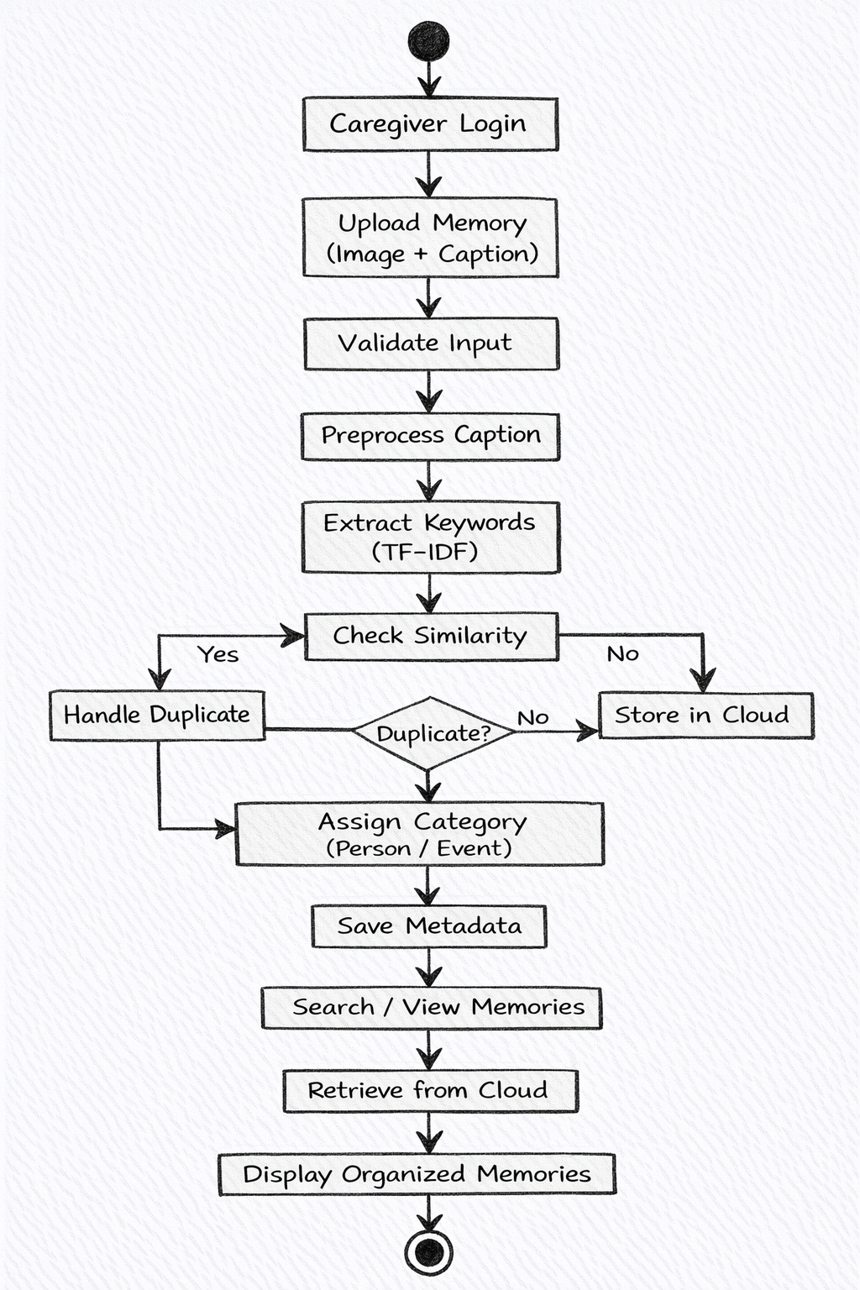
Architectural Diagram
DEPARTMENT OF CSE : MINI PROJECT

Slide 11
PROPOSED METHOD AND ALGORITHMS
The proposed method in NeuroNimbus follows a structured workflow to convert unorganized memory data into a meaningful and searchable format. The process begins when a caregiver uploads an image along with a descriptive caption. The system validates the input and associates it with a specific patient. The caption is then processed using Natural Language Processing (NLP) techniques such as text preprocessing, which includes lowercasing, tokenization, and removal of stop words. After preprocessing, important keywords are extracted and the text is converted into numerical form for further analysis. The system then checks for similarity with existing memories to avoid duplicates and finally stores the processed data in the cloud, where it can be easily accessed and retrieved. The main algorithms used in the system include TF-IDF (Term Frequency–Inverse Document Frequency) for keyword extraction and feature representation, and Cosine Similarity for detecting duplicate or similar memory entries. TF-IDF helps in identifying important words in the caption by giving higher weight to significant terms, while Cosine Similarity compares memory vectors to find similarities between entries. These algorithms are lightweight, efficient, and suitable for real-time applications, making the system scalable and practical for memory reconstruction and management.
DEPARTMENT OF CSE : MINI PROJECT
DEPARTMENT OF CSE : MINI PROJECT

Slide 12
Results
The results of the NeuroNimbus system show that it performs effectively in organizing and managing memory data. The keyword extraction module was able to identify important terms from user provided captions, helping in better understanding and quick recall of memories. The memory categorization module successfully grouped memories into person-based and event-based categories, making navigation and retrieval easier for users.
The duplicate detection module achieved high accuracy by identifying and avoiding repeated or similar memory entries, ensuring a clean and consistent database. Overall, the system achieved an average functional accuracy of around 90%, indicating reliable performance across all modules. The cloud integration also worked smoothly, providing secure storage, stable synchronization, and easy access to memories anytime, which demonstrates the practical usability of the system in real-world scenarios.
DEPARTMENT OF CSE : MINI PROJECT

Slide 13
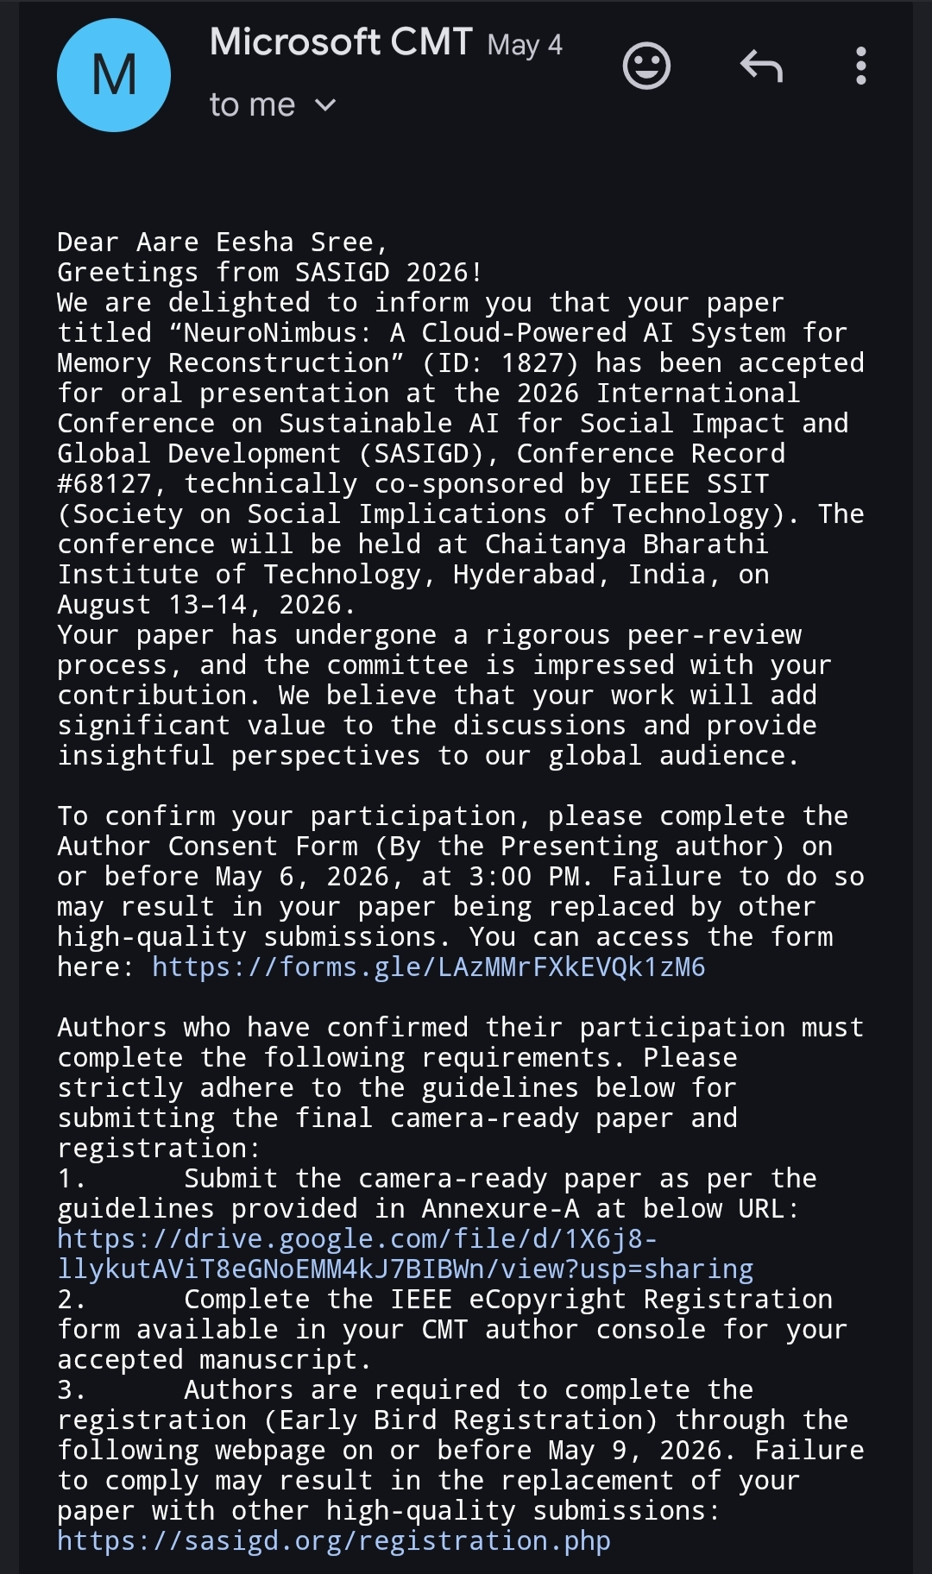
Research Paper (Acceptance Proof)
DEPARTMENT OF CSE : MINI PROJECT
DEPARTMENT OF CSE : MINI PROJECT

Slide 14
Conclusion
In conclusion, NeuroNimbus presents an effective and practical solution for digital memory reconstruction by combining AI, Natural Language Processing, and cloud computing. The system successfully transforms unstructured memory data into an organized and meaningful format, making it easier for users to store, access, and recall important information. Features such as keyword extraction, memory categorization, and duplicate detection improve the overall efficiency and usability of the system.
The lightweight design of the system makes it suitable for real-world applications, especially in environments with limited resources. With secure cloud storage and role-based access, NeuroNimbus ensures safe and convenient memory management for both patients and caregivers. Overall, the project demonstrates how intelligent technologies can be used to support individuals with memory impairments and improve their quality of life.
DEPARTMENT OF CSE : MINI PROJECT

Slide 15
Thank You
DEPARTMENT OF CSE : MINI PROJECT

